Slide 1


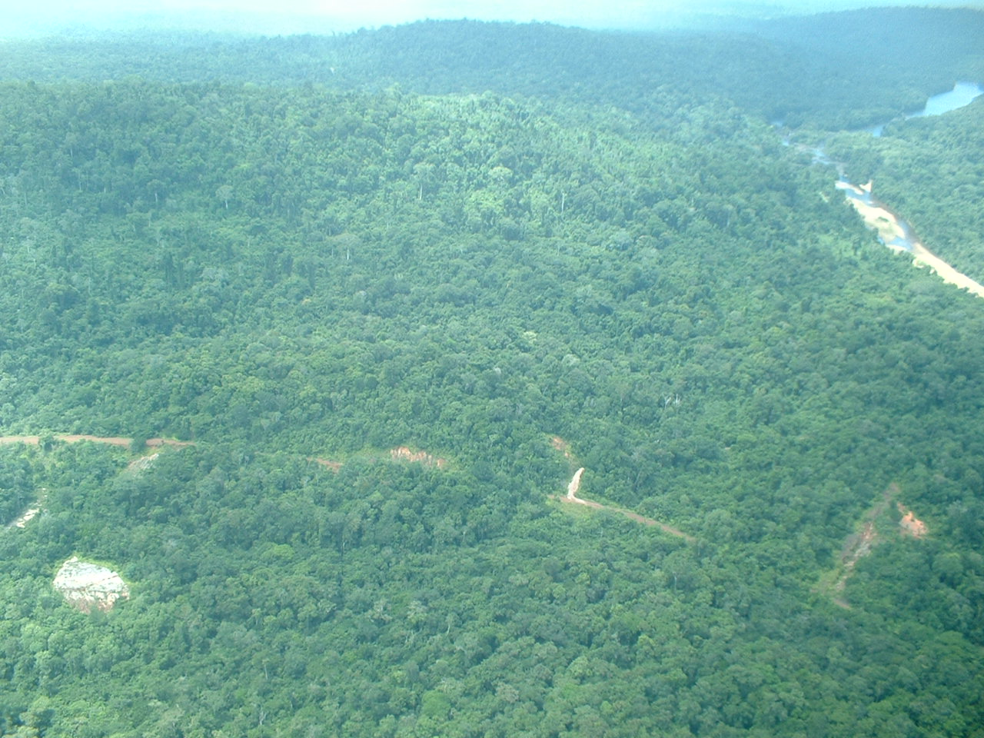
Readiness Preparation Proposal Suriname
Rene Somopawiro, MSc.
October 27th, 2009 Washington D.C.
Notes:
Chair, members of the TAP, FCPF, WB and representatives of the countries, ladies and gentlemen I am grateful very to have this opportunity to present to you our first draft RPP and to provide you with more background information about the development of our RPP and plans to move forward

Slide 2
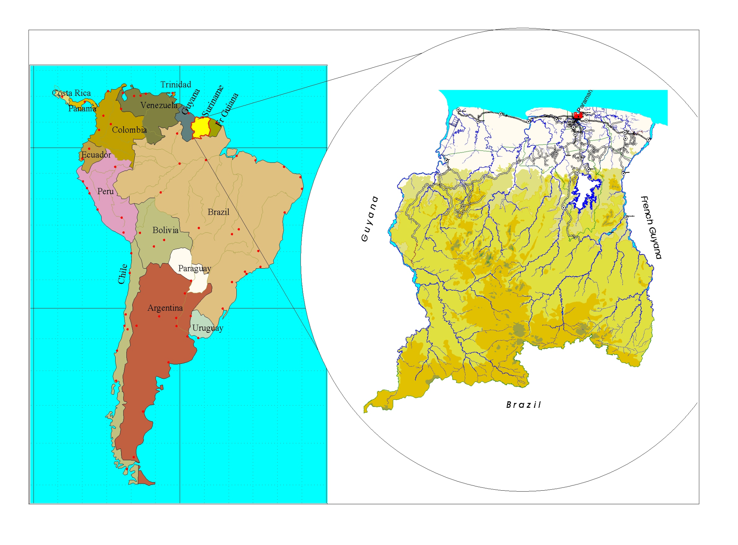

LOCATION SURINAME
Notes:
As you noticed Suriname is located in the Northern part of Latin America, north of Brazil and is a neighbor of Guyana. The official languages is Dutch.

Slide 3
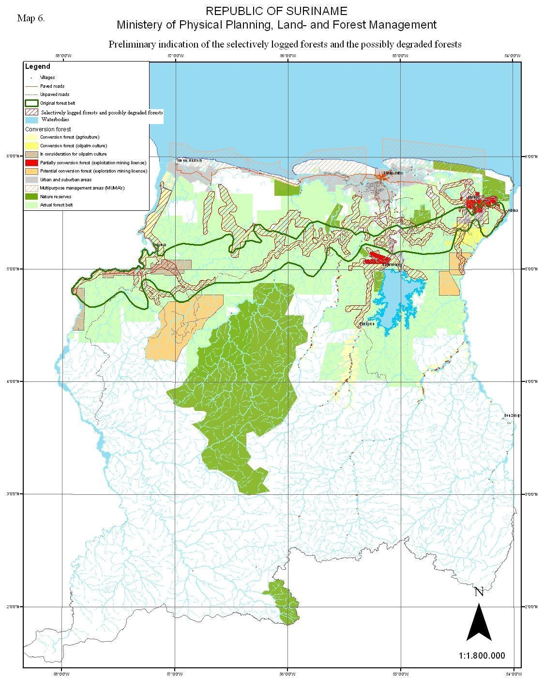
National circumstances
Surface area | 163,820 sq.km
Population (2007) | 509,970 (3.0 per sq. km)
GDP (2007) | 5,073,064(x1000SRD)
Percentage ethnic groups (2005) | 3.7% Amerindians 14.7% Maroons 27.4 % Hindustani 17,7% Creoles and 14.6% Javanese 12.5% Mix 13.1% Others
Population per district (2005) | Paramaribo: 242,946 Wanica: 85,986 Nickerie: 36,639 Coronie: 2,887 Saramacca: 15,980 Commewijne: 24,649 Marowijne: 16,642 Para: 18,749 Brokopondo: 14,215 Sipaliwini: 34,136
Total villages | 234 Indigenous and Maroon villages
Source: General Bureau of Statistics, 2005 and 2008
Notes:
Suriname is about 16.4 million ha, with a population of about 0.5 million people.
Population density is approx. 3/km2
The GDP is about …………..
And the Income per capita is estimated at $3000.
The country is divided in 10 districts. The first 7 districts on the screen are in the northern part of the country where most of the cities are located and are relatively heavily populated and the 3 last ones are more in the south which are relatively less populated. About 8-10% of the population live in hinterland. In the capital the population is more than the half of the population.
We have a multi ethnic population which comprise of:
Amerindians about 3.7 %
African descendant like the creoles which is 17,7% of the total population, Maroons these are the run away slaves 14.7 % of the total population.
Hundustani, descendant from India 17 %, Javanese 14.6 % descendant from the Island Java. Both groups came to Suriname to replaced the slaves after the slavery was abolished in 1863 as contract laborers or paid slaves.
And in addition we have the mixed and the descendant from Libanon, China etc. and the Amerindians (Indegenous people) altogether 3.7% of the total population.
There about: 234 official registered villages in the interior

Slide 4
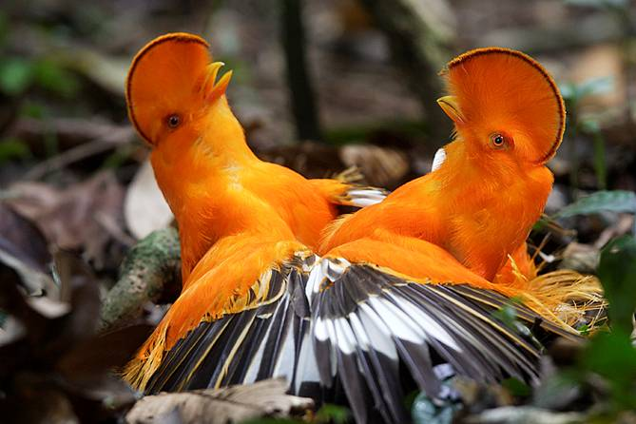

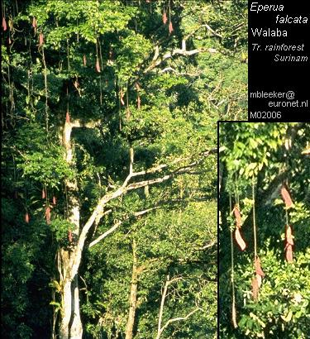
National characteristics' forestry sector
Forestry
  Forest cover: 14.8 million ha (approx. 90% of the total area)
  Deforestation rate: 0.02%/year
  Forest areas:
    Protected Areas : than 2 million ha (13% of total land area, incl. CSNR 1.6 million ha.
    Production forest 4-5 million ha. primarily intended for the production of timber and non- timber forest products This area offers the possibility to harvest 1-1.5 million m3 annually.
Notes:
About 90% of our land area is still covered with forest and we have a deforestation rate of about less then 0.02%/annualy
13% of the forest area is formally protected by law, including the Central Suriname Nature Reserve of 1.6 million ha.
About 4-5 million ha is designated for sustainable timber production with a potential sustainable production of 1-1.5 million ha.
The rest of the forest area is not designated yet for any purposes

Slide 5
National characteristics forestry sector
  State owned forests: 97 %
  Timber Concessions: 1,801,063 ha
  Community forests: 550,449 ha
  Contribution forestry to GDP: 2 %
  Roundlog Production: 160.000-200.000 m3/Year
  % workers to the national work force: 5%
  Laws: Timber act 1947, establishment of the Forest Service, Forest Management Act 1992, Nature Conservation Act 1954, Game Act 1954
Notes:
The state owns almost 97 % of the forest and about 60.000 ha are privately owned.
Timber cutting licenses can be granted by the government such as concessions, exploration rights, icl (salvage logging), community forestry which are granted to forest based communities
Forestry contribute about 2 % to the GDP and together with the indirect incomes such as ecotourism in contributes about 4 % to the GDP . However non monetar,y services as watershed management, biodiversity and other environmental serices are not express yet financiallly to the GDP
Although the potential sustainable timber production of the production forest is 1-1.5 million m3 only around 200.000 m3 are produced annually
5% of the total working force are in the forestry sector
The management of the forest is based on the following lawsT
he management of the forest resources and in particular of the production forest conservation including Game regulation are

Slide 6
Forest carbon and REDD+ linkages with the National Forest Policy 2003
2.3.5 Forest in global perspective
  Responsible for the CO2 sequestration but there are no financial consequences
    Ecological function financially not visible.
    Support innovative financial mechanism for ES.
    Local people benefits is necessary
Paragraph 5.2.3 Conduct research and make use of the Kyoto protocol and market generating income from CO2 sequestration.
  Stimulate the international community to express its responsibility for and interest in the conservation of the environment in more financial support
Notes:
The Government has a very long tradition in promoting SFM and also put a lot of efforts in protecting the forest. During the formulation of the national forest policy in a participatory process the role of forest in climate change mitigation was already highlighted and some actions have been also identified to recognized the efforts of Suriname.

Slide 7
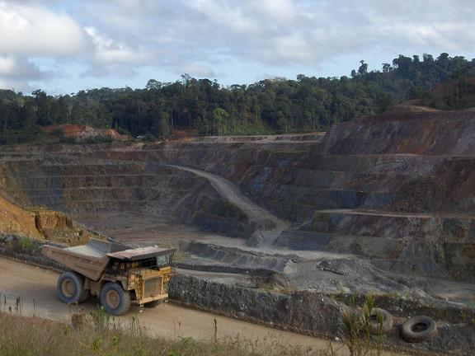
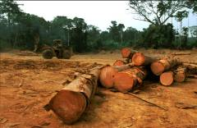
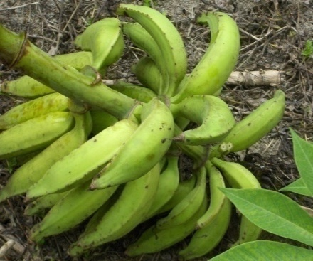
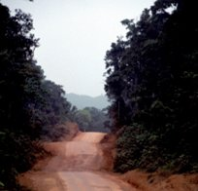
Drivers of deforestation & degradation
Mining |  | 2005 | 2006 | 2007
 | Exploitation in ha | 156,070.56 | 22,520 | 16,075.3
 | Exploration in ha | 3,295 | 191,575.65 | 122,307
 | Small scale mining in ha | --- | --- | 1,400
Forestry (2008) | Timber concession area: 2,5 million ha Round log Production: 160-200.000 m3/Year
Agriculture (2004 – 2008) | Cultivated area, grass land for cattle stocks and land use: 131,384.90 ha, shifting cultivation 240.000 ha
Infrastructural development (2006) | City: 1,170 km Other districts: 3,465 km Bridges: 172
Energy production (2007) | NV EBS: 912,908,912 kWh (hydro and diesel generation) State Oil Company: 25 kWh Hydro-lake: 150.000 ha ( production of hydropower)
Source: General Bureau of Statistics, 2008
Notes:
Presentation of the drivers of deforestation. These information have been produced in particular by a quick scan and desk studies and with the input of the different relevant institutions
Mining in particular Bauxite and gold mining, small scale illegal and illegal goldmining,
For forestry it can be mentioned that so far no significant deforestation has taken place but more forest degradation. But in the other hand its stated that Suriname has enough forest and that there is opportunity for all sector
There is a need for in-depth assessments to clarify the rate of deforestation and forest degradation and the main drivers. The country’s Multi Annual Development Plan (MOP) for 2006 – 2011 states that the Government of Suriname is working on a specific target of enlarging the area under active timber exploitation by 2010, for the purpose of expanding the timber export volume. Expansion in the mining, agriculture and energy sectors is also envisioned in the MOP.

Slide 8
Readiness Preparation Proposal (RPP)
Objective:
To come to an efficient and effective mechanism for the development and implementation of REDD+ readiness strategies into the overall national development through strengthening of capacity and capabilities of all relevant (governmental) institutions and stakeholders as well as to increase national (economic) development along with sustainable forest management and appropriate monitoring and enforcement.
Basis:
The Multi- Annual Development Plan
The National Forest Policy
The National Environmental Policy,
Continuous awareness raising and shared learning,
Continuous stakeholders meetings considering the governmental and traditional structure
Outcomes of international negotiations regarding REDD (COP and relevant bodies)
Notes:
Activities conducted to develop the RPP:
8th – 12th September 2008, Suriname hosted the international experts meeting on “Financing for Sustainable Forest Management: The Paramaribo Dialogue”, which was a Country-Led Initiative (CLI) in support of the United Nations Forum on Forests (UNFF). The objective of the Paramaribo Dialogue was to identify opportunities to significantly enhance financing for sustainable forest management.
After Suriname’s RPIN was approved in February 2009, the Ministry of Physical Planning, Land and Forest Management in collaboration with Conservation International Suriname, World Wildlife Fund Guianas and Tropenbos International Suriname, initiated a series of Workshops, which focused on Reduced Emissions from Deforestation and Degradation (REDD+), the climate change negotiations and opportunities for Highly Forested and Low Deforestation (HFLD) countries.
With respect to capacity building for technical cadre of governmental institutions, the Anton de Kom University of Suriname, non-governmental institutions and representatives of Indigenous and Maroon organizations, Conservation International supported the Government of Suriname in providing the training course “Forest Carbon Project Development and REDD+ Readiness for the R-PLAN Development”
Participation of the Ministry of Physical Planning, Land- and Forest Management (RGB) within the Forest Carbon Project Development training workshop for Indigenous and Maroon community leaders organized by Conservation International Suriname. The Ministry did a presentation on the RPP with emphasis on components 1a and 1b.
Desk research and meetings with key persons to obtain more data and information
As a result of all of the above-mentioned activities, an increased knowledge and awareness of REDD+ issues has become apparent, among governmental institutions, the Anton de Kom University of Suriname and other technical institutions, stakeholders, Indigenous and Maroon organizations, timber companies, and civil society organizations

Slide 9
Process to the development of the RPP
In-Country Capacity
RPP evaluation
Considering TAP
Development of the RPP
REDD and HFLD Awareness
&Training
R PIN
NFP, NEP, NBS
CLI 2008
Accepted in March 2009
Awareness
Training
Workshops
Stakeholders meetings, desk research
National REDD plus Committee
RPP follow up
Stakeholders
meeting
March 2009
August 2009
October 2009
Notes:
In the NFP, NEP, NBS it is already stated the role of Forests in Climate Mitigation and the need that country like Suriname is be recognized for its effort in implementing SFM, including conservation of its forests
Within the framework of the CLI meeting on forest finance mechanism of UNFF in 2008 the process has been initiated to participate in WB FCPF program by submitting the R-PIN to World Bank
After the acceptance of the R-PIN by the world bank a workshop has been organized about the R-PIN that was submitted and the follow –up activities that are needed including the formulation of the RPP
Stakeholders meetings and training were conducted and in addition a National REDD-Committee has been established to take the lead and responsibility to Draft the RPP
RPP will be evaluated and when necessary updated taking into account th e Recommendation and Comments of the TAP and the stakeholders during the follow –up consultations meeting
Stakeholdersmeetings uitzetten
Het is een government initiatief om met de WB te werken
We hebben direct de relevante ministeries en cabinet dan erbij en met de bedoeling om gaande weg de anderen mee te nemen

Slide 10
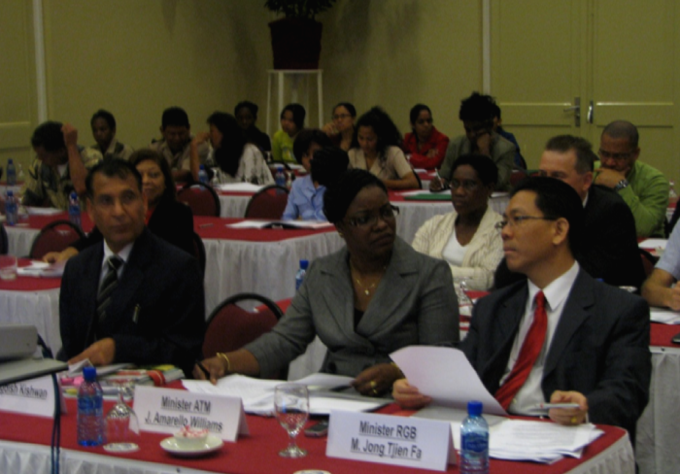
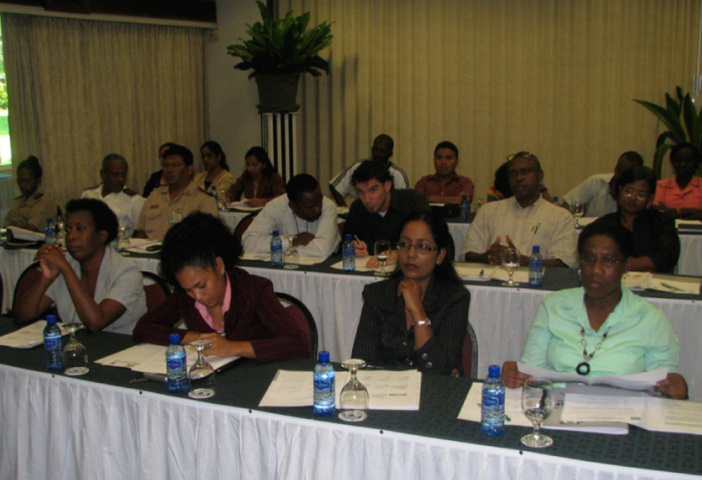
Stakeholders meeting and training RPP
8th – 12th September 2008:
  Suriname hosted the international
  experts meeting on “Financing for Sustainable Forest Management: The Paramaribo Dialogue”, which was a Country-Led Initiative (CLI) in support
  of the United Nations Forum on Forests (UNFF). Preparation meetings
March - June 2009:
  3 Workshops regarding R-PIN, REDD+, the climate change negotiations and opportunities for Highly Forested and Low Deforestation (HFLD) countries & 1 spatial planning training for technical institutions.
Notes:
September 2008 8-12 CLI meeting on Forest Finance. Submissions of the R-PIN
March-Juni: Bas Clabbers (EU, Netherlands), Kiswan Jagdesh (India), (CI), Ben Vitale Ralph Aston terristrial Carbon Group)
May 2009, Training to all stakeholders to be on the same level regarding information of RPP, CARBON, CLIMATE CHANGES and intitial process to formulate R-PP
Augustus: Participation Min RGB in training special for indigenous and Maroon Communities

Slide 11
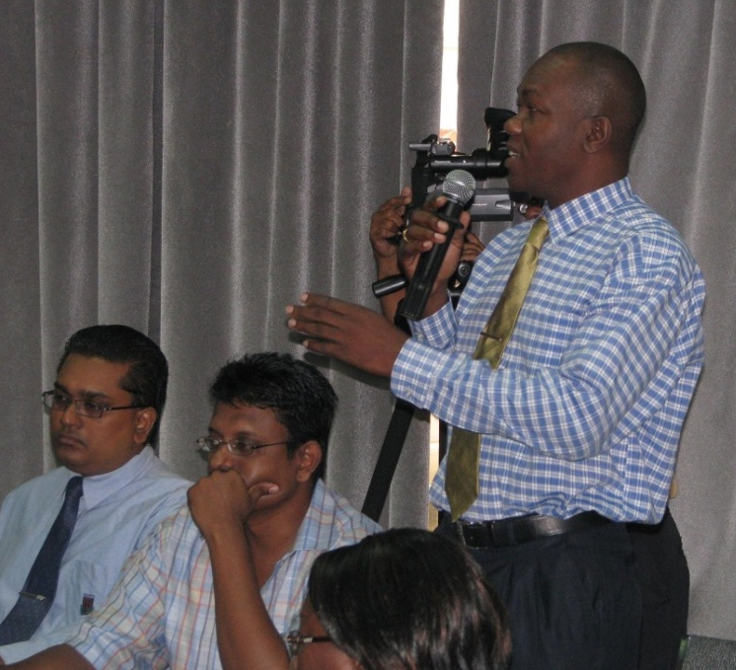
Stakeholders meeting and training RPP
May 2009:
Conservation International supported the Government of Suriname in providing the training course “Forest Carbon Project Development and REDD+ Readiness for
the R-PLAN Development”
Augustus 2009:
Participation of the Ministry of Physical Planning, Land- and Forest Management (RGB) within the Forest Carbon Project Development training workshop for Indigenous and Maroon community leaders organized by Conservation International Suriname. The Ministry did a presentation on the RPP with emphasis on components 1a and 1b.

Slide 12
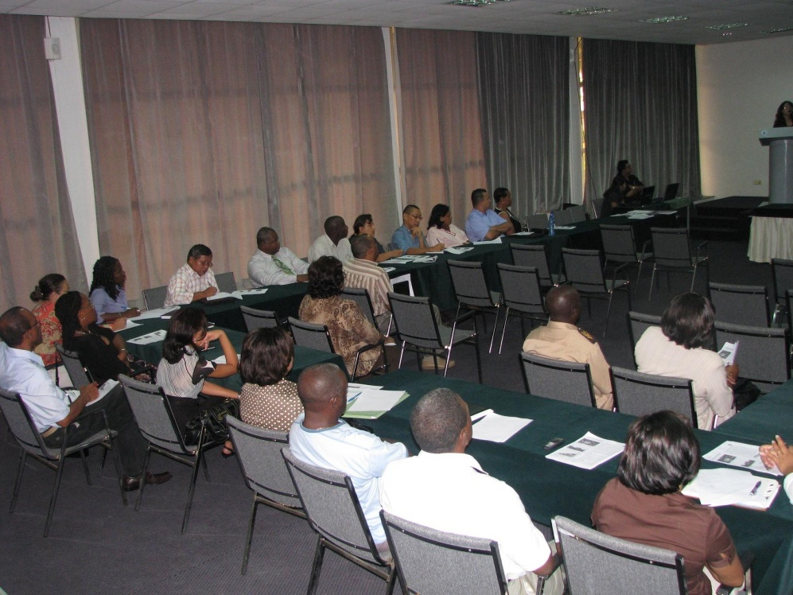
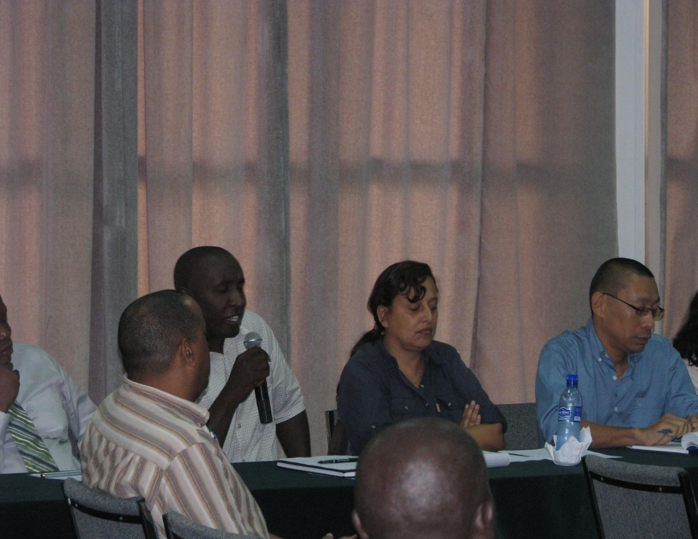
Stakeholders meeting regarding the development of the RPP
Meetings:
  July 6th, July 31st, and August 17th 2009.
Notes:
July 6th: component 1a and 1b
July 31st: component 2, 3 and 4
August 17th: component 1a, 1b, 6

Slide 13
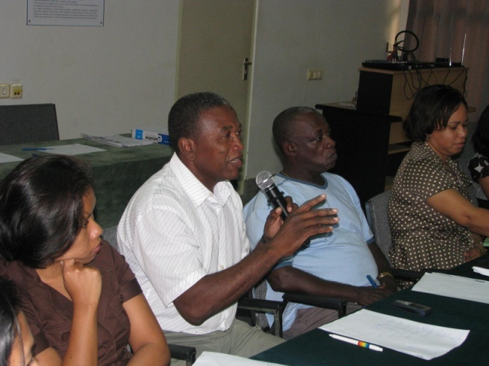
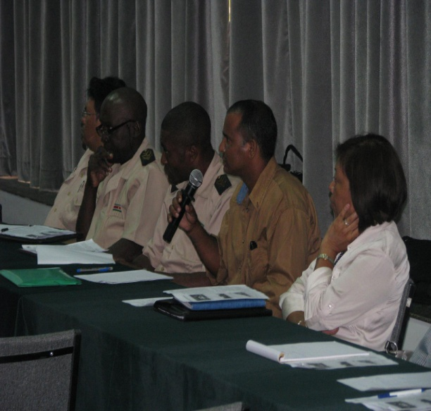
Some important outcomes of the stakeholders meeting
‘More awareness is needed about REDD+ readiness strategy’;
‘Dissemination and providing of information is important’;
‘Needs time for consultation meetings in order to ensure a good understanding of the REDD+ readiness strategy’;
‘Giving sufficient time for internal consultations within the Indigenous and Maroon villages’;
The land rights of Indigenous and Maroons communities must be taken into account”
Notes:
During the three stakeholders resulted among others in the following important outcomes:

Slide 14
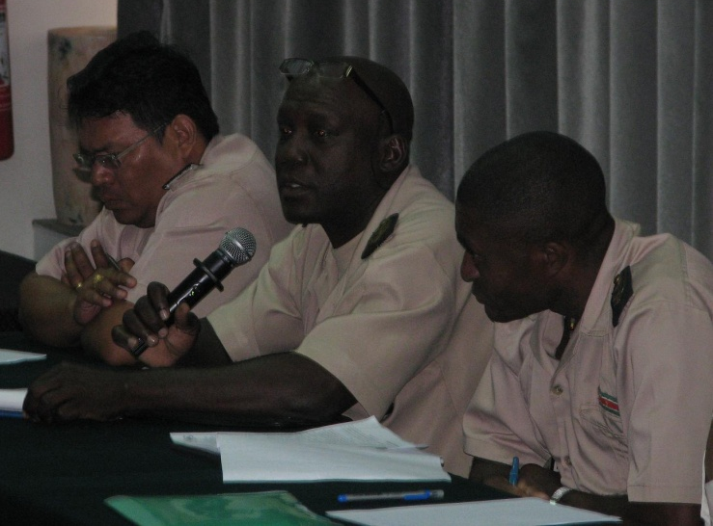
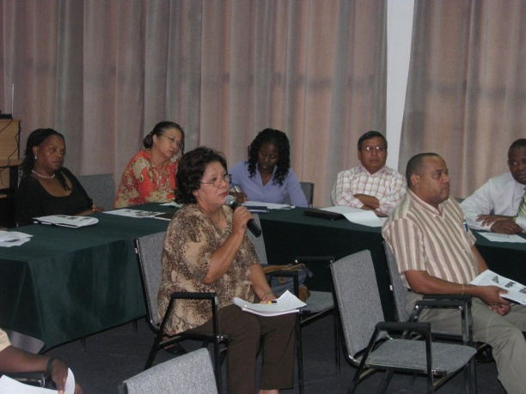
Some important outcomes of the stakeholders meeting
‘Any effective and efficient consultation model must be based
on the principle of FPIC’;
‘The national and local languages must be used during consultations and in education and awareness programs to ensure a full understanding’;
‘All information must be sent to the organizations and representatives of traditional authorities in hard copies in a language that they can understand’

Slide 15
Current national circumstances MRV
Log tracking system
GIS unit within the Forest Authority
GLIS project
Quick Scan of Forest Carbon Stock
Conducting carbon baseline assessment and carbon dynamics of the forest
Initial process for the establishment of the MRV
Agriculture census 2009

Slide 16
Important actions for future development of the MRV
In depth data collection as well as assessment of the drivers of deforestation and forest degradation
Need for capacity and institutional strengthening
  Capacity building to conduct regular forest inventories and mapping
  Increase of skills, expertise and knowledge GIS and monitoring
  Capacity building for biomass monitoring, carbon accounting and measurement plots
  Carbon accounting, baseline studies, reference scenarios'
Notes:
Data collected based on studies en research in the past. All available data in relation to REDD + were thoroughly inventoried. And all the relevant institutions dealing with deforestation and forest degradation were involved in the stakeholders meeting
It was noticed there was a lack of data, A lack of expertise and knowledge, and overall institutional strengthening is needed to do an in depth study on the drivers of DD collect data and to establish and implement an efficient MRV system. More over because it is a very new process for us
Results of Initial data collection drivers of deforestation and forest degradation
Data and Record collection as well assessment of these with respect to the relation of REDD+
Lack of expertise and knowledge
Need for capacity and institutional strengthening
Log tracking system
GIS unit within the Forest Authority
GLIS project
Quick Scan of Forest Carbon stock _UN_REDD
Tropenbos International Suriname: Carbon baseline assessment, Carbon dynamics of the forest
Spatial planning training for the technical institutions
Initial process for MRV
However some actions has been taken within this regards such as:

Slide 17
RPP Budget
Component | U$D in thousands
Component 1a: National Readiness Management Arrangements | 540.00
Component 1b: Stakeholder Consultation and Outreach Plan | 7,100.00
Component 2a: Assessment of Land Use, Forest Policy and Governance Activities | 803.00
Component 2b: Strategy Activities | 1,660.00
Component 2c: Implementation Framework Activities | 1,075.00
Component 2d: Social and Environmental Impact Activities | 1,475.00
Component 3: Reference Scenario Activities | 1,275.00
Component 4: Monitoring Activities and Budget | 1,195.00
Component 6: Program M&E Activities and Budget | 113.00
GRAND TOTAL RPP | U$D 15,236.00
Notes:
According to our first assessment the implementation of the RPP will cost about 15 million ha during the 4 year. And as you noticed the component 1b: Stakeholders consultation and outreach plan will costs about 7 million alone to make sure that the advises and proposals during the several stakeholders meeting are taken into account.

Slide 18
Follow up
Address President Opening Parliamentary Year 1 October 2009: ‘commitment to climate change and forests’
Initial Forest carbon assessment and Spatial planning training
The Suriname Green approach “Green Vision” , October 2009:
  Green Development Plan assembled by the Government and with a broad array of partners and stakeholders
  Highlights of environmental sustainability as a guiding principle for policy making and investment
  Provide a valuable tool for preparing the new (2012 – 2017) 5 year National Development Plan
Awareness raising regarding clear understanding of REDD strategies as well as the RPP
  Accessibility of documents and information on REDD
Notes:
BOSSEN ALS VAN EEN RECHTVAARDIGE GANG VAN ZAKEN BIJ DE BENUTTING VAN ONS POTENTIEEL AAN BOS EN ANDERE NATUURLIJKE hULPBRONNEN, WERKT DE REGERING MET INSCHAKELING VAN NATIONALE EN WAAR NODIG OOK EXTERNE DESKUNDIGHEID, AAN DE OPLOSSING VAN HET GRONDENRECHTENVRAAGSTUK IN ONS LAND.
During the Yearly address to the Parliament of the President again express his commitment to continue our support and efforts to stabilize the Climate by maintaining the conservation on forest with the assumption that world community are willing to the financially recognize the efforts that’s has and will be made by Suriname
In that framework the forest policy of Suriname on SFM and forest conservation will improved by the introduction of Suriname Green Vision Strategy by the Minister of Planning and Development and Development Cooperation.
Carbon Stock assessment and a spatial planning training is going on
Awareness raisin regarding REDD strategies, REDDD as well as the RPP will be conducted

Slide 19
Follow up
Two conference call meetings
October 21st, 2009:
  First stakeholder meeting regarding the first TAP
  7 recommendations were discussed with relevant stakeholders inclusive governmental and non-governmental stakeholders, private sector inclusive the mining sector, academia, indigenous and maroon organizations.
Continue with stakeholder meetings to discuss the TAP comments in depth
Continue with improving the RPP
Continue with awareness raising
Notes:
After receiving the TAP comments and the conference call meetings were taken place within the National REDD+ committee to review and a consultation meeting took place to discuss the first TAP meeting.
The remaining TAP comments will be discussed during stakeholders meeting.

Slide 20
Thank you

